Slide 1
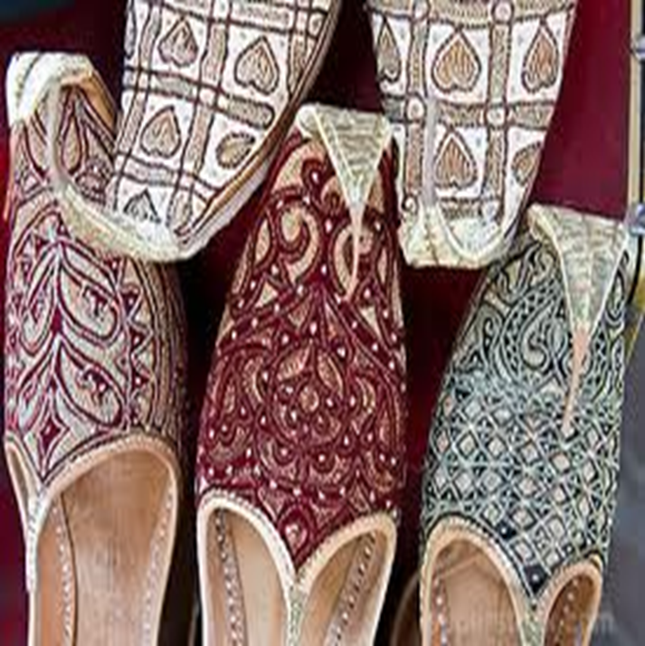
Lesson 6-7: الدرس السابع
Objectives:
Review
The morning greeting
Asking about well being
Arabic alphabet: two way connectors continue
Practice
Summary
Welcome to Arabic Level I by Kurzban

Slide 2
Lesson 6: Review: Do Now
Copy the following words down on a ruled sheet of paper. Remember that { ra, waw, & zay} descend slightly below the line, where {dal, thal} do not. Proceed from right to left. Do you recognize these letters and their vowels?
رَذاذْ دُوَّار رِدادْ ذُرور

Slide 3
Alphabet: Two way Connectors
س ش ج ح خ ف ق ة

Slide 4
Alphabet: Two way Connectors
س ش
The letter sin س and shin ش has one basic form. They are differentiated by the 3 dots placed above the shin

Slide 5
Alphabet: Two way Connectors
س ش
Forms of Two –Way Connectors: Initial Medial Final Final Name Symbol Connected Unconnected _____ ________ _______ _______ ______ _______ _____ ________ _______ _______ ______ _______

Slide 6
Please note!
In Arabic handwriting, at times, the three dots can be replaced with a caret: in this case _____________ and also, the two dots can replaced with a horizontal stroke: in this case ______

Slide 7
Let’s practice with س ش
شَ+ر + ا + ر =
سَ + رِ + ي + ر =
يَ + ا + س + ي + ن =
رِ + ي + ش =
يُ + شِ + ي + ر =

Slide 8
Alphabet: Two way Connectors
خ ج ح
The sound of the letter خ ( kha) is similar to the final consonants in German Bach & Scottish Loch

Slide 9
Alphabet: Two way Connectors
ج
The sound of the letter ج ( jim) usually pronounced just like the s in Pleasure.

Slide 10
Alphabet: Two way Connectors
ج
In parts of Egypt and Yemen it is pronounced g as in {Gabe}
In Holy Qur’an, it may be pronounces like the j in judge.

Slide 11
Alphabet: Two way Connectors
ح
The sound of letter ح (ha) as of {Hakim}, there is a hard h that is voiceless

Slide 12
Alphabet: Two way Connectors
خ ج ح
Forms of Two –Way Connectors: Initial Medial Final Final Name Symbol Connected Unconnected _____ ________ _______ _______ ______ _______ _____ ________ _______ _______ ______ _______ _____ ________ _______ _______ ______ _______

Slide 13
Let’s practice with خ ج ح
١} جَ + ا + ر + و + ر =
٢} رِ + ح + ا + ب =
٣} سِ + نْ + جَ + ا + ب =
٤} شَ + خِ + ي + ر=
٥} خَ + سِ + ي + س=

Slide 14
Lesson 7: Homework: Copy down these words and practice writing them as many times as you can. (12 separate lines)
تين بيَّان ثِياب نَبِيذ بَارُود {A
رَتيب ثابِت زِرياب يَدان رَباب {B
نَعم لا{C

Slide 15
Lesson 7:
The morning greeting has the same function as its English counterpart. You may respond to this greetings, using the same phrase or another one which differs only in the second word.
& its response:
صَباَحُ الخَير

Slide 16
Morning Greeting
صَباَحُ النور

Slide 17
Asking about Well -Being
Usually when two people greet each other, they also ask about each other’s well-being.
How are you doing?
كَيفَ الحال؟

Slide 18
Asking about Well-Being
The culturally appropriate response is a positive one. That is, one is not expected to complain even if one is not faring well.
الحَمدُ لله بِخَيْر
It literally means” Thank God, I’m well”

Slide 19
Summary
Identify the letters that we have covered during this lesson by circling them:
حضرتك لطيفة. You are very kind
انا اسفة Sorry
شكرآ جزيلآ Thanks a lot
بخير، الحمد لله. وكيف أنت؟ Fine, and you?

Slide 20
ف ق ة If time permits: Continue

Slide 21
Do Now
How do you say?
1
2
3
4
5
6
7
8
9
10

Slide 22
Review
Review
Make your flash card for this lesson
Questions????

Slide 23
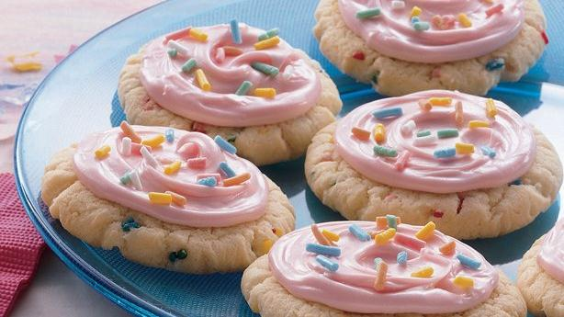
Cookies Today by Megan M

Slide 24
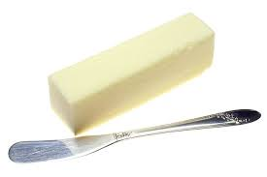
Ingredients
زبدة

Slide 25
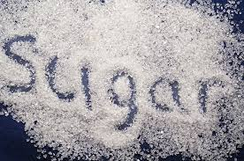
Ingredients
سكر

Slide 26
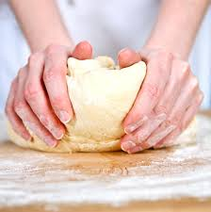
Ingredients
كعكة العجين

Slide 27
Ingredients
الرشات السكر

